Slide 1
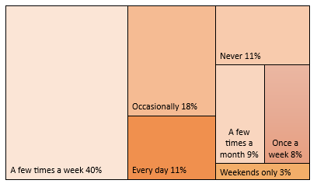
…continuing the conversation about alcohol
A recent consultation ‘A conversation about drugs and alcohol’ helped us to better understand the needs of people with drug and alcohol disorders in the county. One of the most important areas was reducing the harm associated with excessive drinking and we were keen to understand more about this by continuing the conversation. This involved 143 service users and ESCC residents responding to an online survey and a further 45 attending a focus group in Aug/Sep 2020.
How often people are drinking alcohol
Changes in drinking habits during Covid-19 lockdown | %
The number of days that I drank alcohol increased | 46%
The amount of alcohol I drank increased | 37%
Both the number of days that I drank and the amount of alcohol I drank increased | 35%
Coping mechanism
Boredom
Something to do
Isolation
Reason for change
Over half of online respondents felt they have a healthy relationship with alcohol.
More than half of people no longer feel safe in pubs and bars since they re-opened
Environment is important
Access to more safe places are needed for those in recovery (without alcohol reminders such as advertising and without judgement).
Before Covid-19
After re- opening

Slide 2
75% know where to go for help
55% aware of One You East Sussex
46% have employee assistance at work
40% aware of support for under 19’s
Getting support with alcohol harm and addiction
The majority prefer getting advice online.
But digital access is an issue for many.
Main issues that people feel need addressing:
Support needs to encourage connection and reduce isolation.
Training for professionals on minimising harm and positive recovery.
Issues with alcohol should not be ‘played down’ in importance.
Specific support needed at each stage of treatment and recovery.
Alcohol harm education from school through to adulthood is important.
Safe places and safe people without judgement are vital for recovery.
Alcohol harm on family and relationships is significant.
Digital exclusion – make online support more accessible.
What’s next:
This feedback will inform the next East Sussex Alcohol
Harm Reduction Strategy.
A learning event for services and professionals to better
understand substance misuse.
Work with STAR to demystify treatment for those with alcohol disorders.
Existing 'life-long' relationship with alcohol worsened and finally overstepped what's sustainable and made it more visible.
In the recovery community I’ve realised there are thousands of us with the same addictive behaviours.
The pandemic has had the opposite effect - I have reduced my intake of alcohol due to not socialising and not going to bars/pubs. I have made changes to my lifestyle to do more exercise and have lost weight and improved my fitness level.
These last 5 months have been the most mentally and emotionally challenging I have ever faced. Alcohol can mitigate worrying about essential day to day necessities

